Slide 1
The Manufacturer of Larox Valves and Pumps
27.10.2011

Slide 2
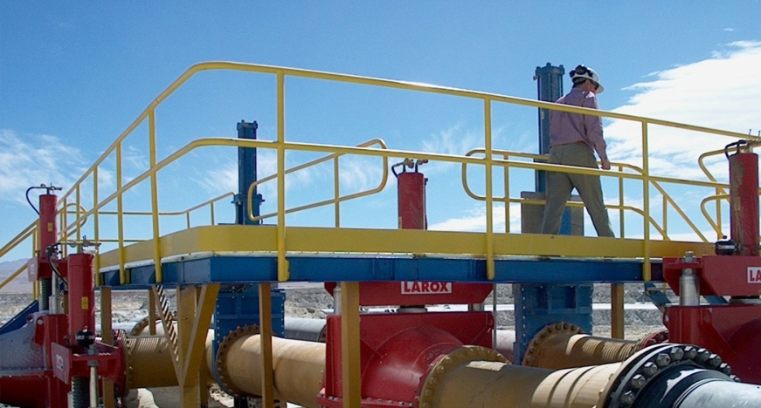
Flowrox is
Proven Performer
30 years of experience
70,000 installations worldwide
55 countries with local service
Solution Provider
For demanding duties
For a variety of industries
For right selection and sizing
Reliable Partner
With comprehensive product portfolio
With certified ISO 9001 process
With reliable on-time deliveries

Slide 3
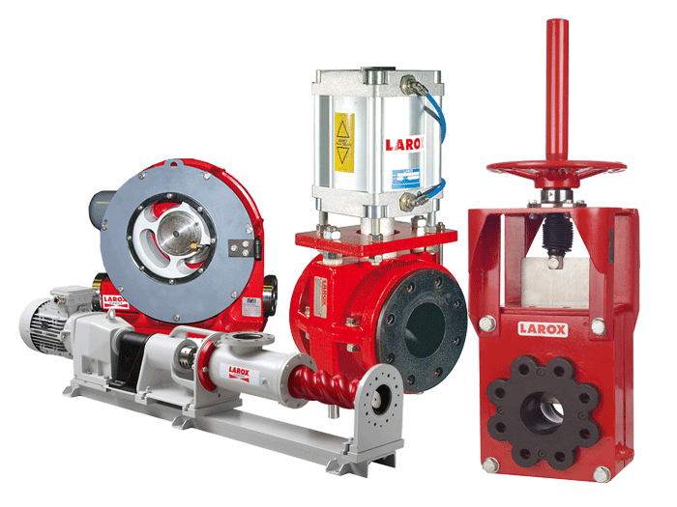
High Quality for Demanding Applications
Pinch Valves
Shut/off or control applications
Heavy Duty Knife Gate Valves
Shut/off applications
Peristaltic Pumps
High density slurries, chemical dosing and accurate metering
PC Pumps
Slurry and paste applications

Slide 4
Flowrox in Australia
AEM represent Flowrox in South Australia in sales and service
Flowrox In Australia
First office in August 2010
Warehouse in April 2011
Assembling of valves
Sales and technical support
Supported by global organization
Quality systems
Product management
Application knowledge
R&D
Notes:
Larox Flowsys Solution
We focus on abrasive, corrosive and other demanding shut-off, control and pumping applications serving a wide range of process industries worldwide.
We are solution providers, driven by the will to solve problems; understand and help make our customers´ processes more competitive.
We work in partnership with our clients to specify, design and deliver the optimal solution.
“Larox Flowsys solution” refers to the total value proposition comprising of
Customer focus and cutting–edge product and service solutions
Industry Expertise
Process and application know-how (Expertise in demanding applications)
Global reach, local service
Reliable project deliveries and OEM partnerships
Innovation through R&D
4

Slide 5
Peristaltic (Hose) Pumps

Slide 6
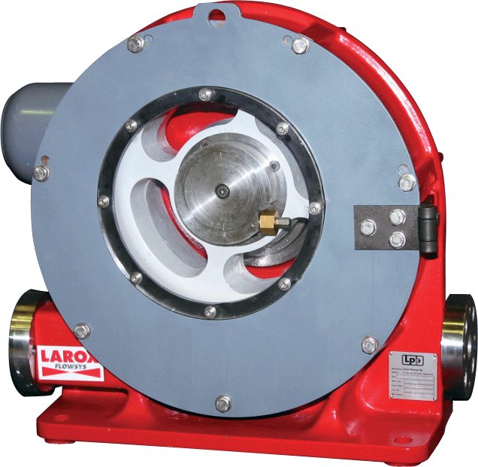
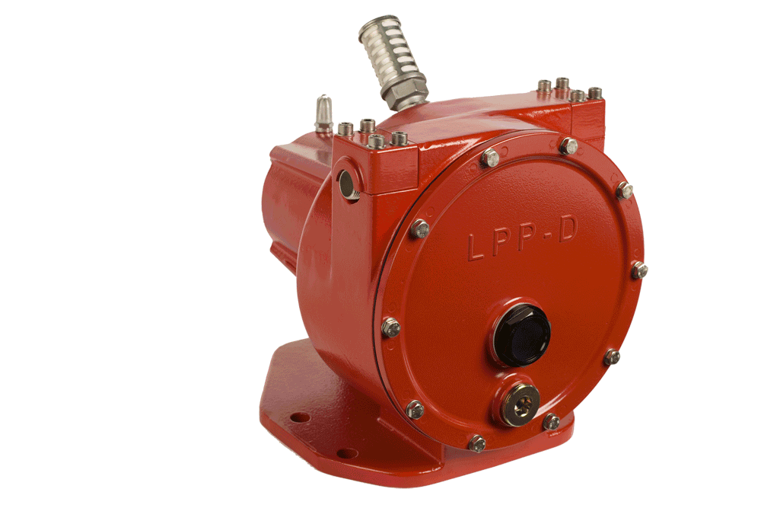
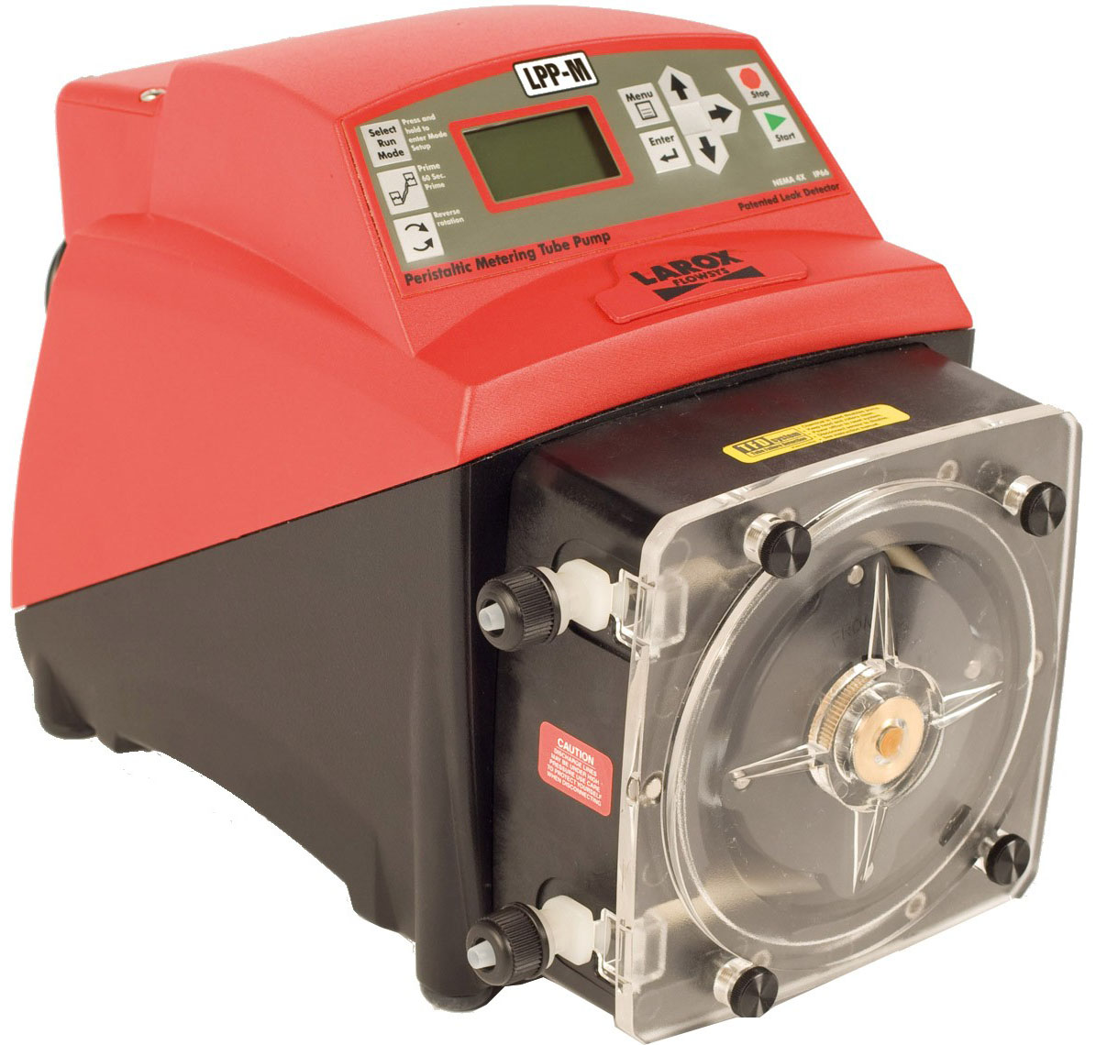
Flowrox Peristaltic Pump Family
LPP-T for transferring duties
Size range: 0.3-40 m³/h
Maximum operating pressure: 10 bar
Soon 100 m³/h at 16 bar 24/7
LPP-D for dosing duties
Size range: 0.06-2.0 m³/h
Maximum operating pressure: 16 bar
LPP-M for accurate metering duties
Size range: 0-0.13 m³/h
Maximum operating pressure: 8.6 bar

Slide 7
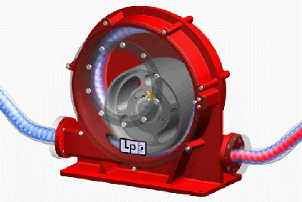
The Advanced LPP-T and LPP-D Design
Flowrox Pump
Process Benefits
Conventional hose pump
360 degree
operating cycle
Higher flow per compression than any other peristaltic pump
180 degree operating cycle
Only one compression
per revolution
Extended
hose life
Two compressions per revolution
Rolling
hose contact
No overheating
Shoe contact generates friction and heat
In-line
pipe connection
Simple
installation
Pressure and vacuum lines same side of the pump
Low lubrication need,
low energy consumption
Low
operating costs
High lubricant need for cooling
Flowrox LPP
Conventional hose pump
Notes:
7
One Compression is All You Need
A single, bearing-mounted roller presses against the hose only once per the 360 degree operating cycle,
producing the maximum flow per revolution and offering the longest lifetime possible.
The trailblazing LPP pumps produce higher flow per hose compression than any other peristaltic pump. They are designed to operate continuously at high speeds and in high pressures without the risk of overheating making them perfect for heavy duty applications.
Unique Rolling Design
Larox LPP pumps incorporate an advanced design, which eliminates friction, maximizes hose lifetime and lowers energy consumption. The roller is mounted on a crankshaft creating eccentric rotation during the 360 degree operating cycle. Compared to conventional peristaltic pumps, the LPP pumps double the flow per hose compression.

Slide 8
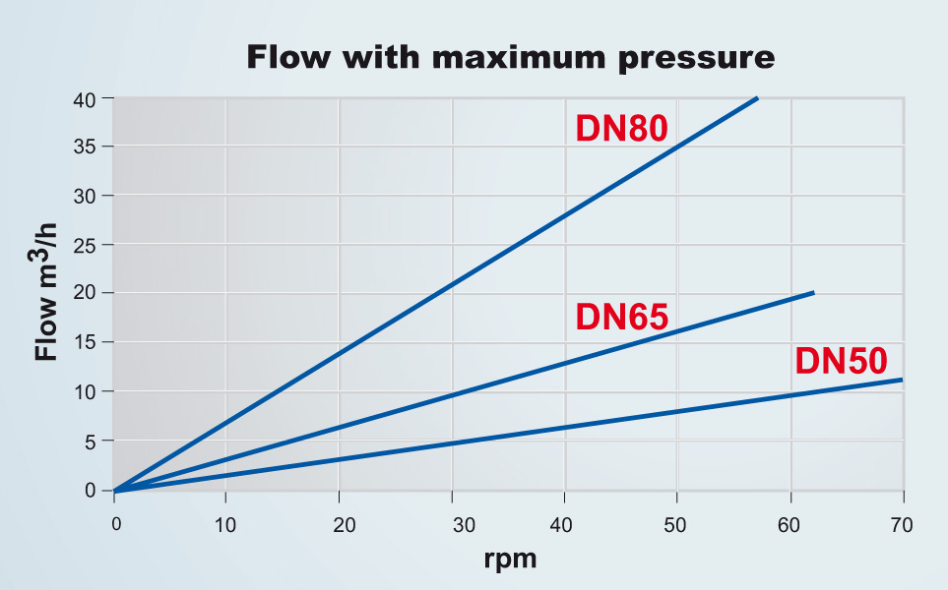
LPP-T Technical Data
Flowrox LPP T Performance
at nominal pressure and at
Continuous operation 24/7
any temperature up to 90ºC
Notes:
Flow Rates
Pump size Flow rate
LPP 25 up to 2.2 m³/h
LPP 40 up to 8.5 m³/h
LPP 65 up to 20 m³/h
LPP 80 up to 40 m³/h
The maximum discharge pressure is 10 bar

Slide 9
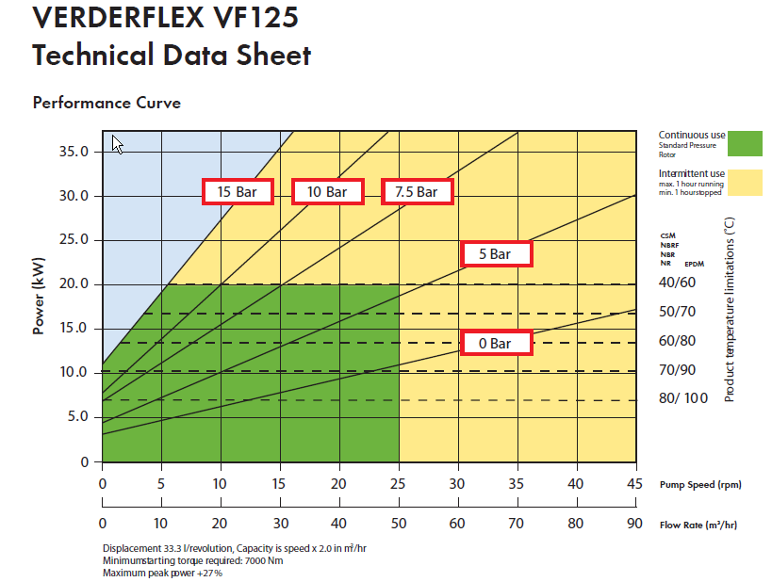
Conventional hose pump
mm

Slide 10
Conventional hose pump
mm
LPP-T80, 40m3/hr @ 7,5 bar, 18,5 - 22 kW motor @ > 90 deg C
Verderflex 125, 80 deg C

Slide 11
Flowrox
LPP T100
The largest pump available
100 m³/hr @ 16 bar > 90 deg C, 90 kW
LPP-T100
100 m³/hr @ 10 bar, > 90 deg C, 55 kW
Competing
Double 100 mm

Slide 12
Low Operational Costs
Operational Costs | LPP-T65 | Conventional Hose Pump 80 mm
Hose changes (times/year) | 5 | 10
Spare hoses (€/year) | 4200 € | 10 400 €
Lubricant (l/hose, €/year) | 3 l, 300 € | 20 l, 3 800 €
Electricity (kW, €/year) | 7,5 kW, 2100 €/year | 15 kW, 3800 €/year
Maintenance (h/year, €/year) | 80 h, 2700 €/year | 150 h, 5100 €/year
Total operating costs per year | 9 300 € | 23 100 €
Notes:
Price LPP-T65: 12 800 €
Electricity costs: 7,5 kW x 24 h/day x 360 day/year = 64 800 kWh/year x 0,05 €/kWh x 0,8 ~ 2600 €/year @ 80% load
Maintenance cost = 45 €/h
Cost difference in a year (benefit for LPP-T65): +22 900 €
Payback time (months): 12 800 € / 22 900 € ~ 7 months

Slide 13
Progressive Cavity (PC) Pumps
Available in 2012
Risto Ruutiainen,
PC Product Manager

Slide 14
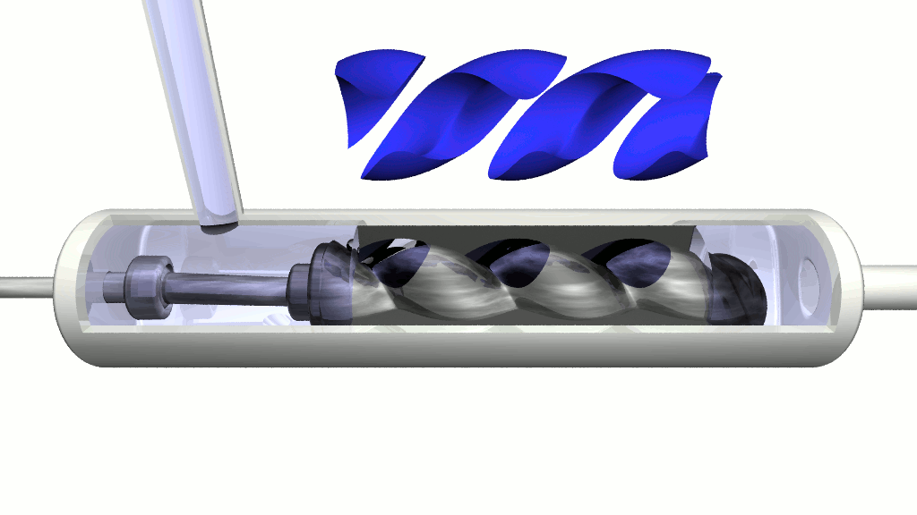
Progressive Cavity Pump
”PC-Pump”
The progressive cavity pumps belong
to the positive displacement pump group
Developed by French Professor
René Moineau in 1930’s
Known also as
Mono pump
Eccentric screw pump
”Worm pump”
Almost pulsation free pumping

Slide 15
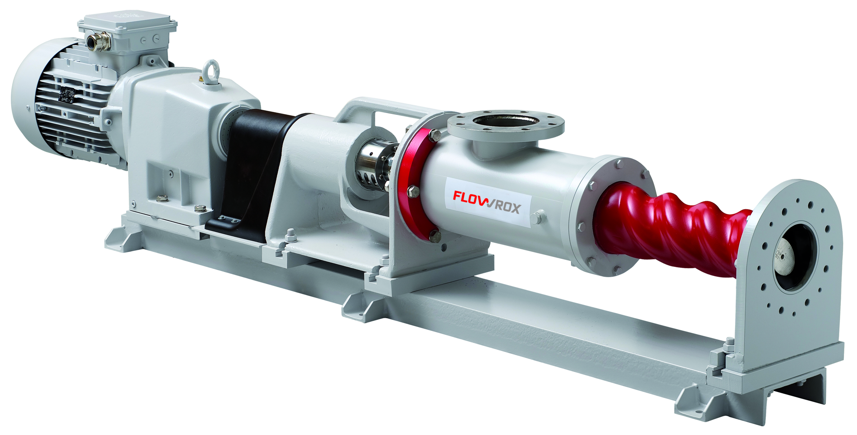
Typical Industries
Pulp and Paper
Paper machine coating chemicals
Other P&P chemicals
Water & Waste Water
Waste water sludges
Chemical Industry
Mining, metals and minerals
Energy and environment
Oil and gas
Food, beverage and brewery
All high viscous and/or shear sensitive liquids and sludges

Slide 16
Paste pumping

Slide 17
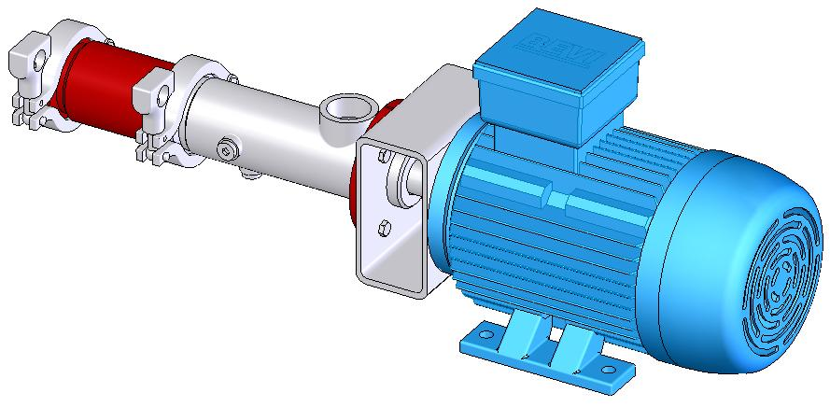
PC-Pump Models
E-Series
D-Series
0,04…0,75 m³/h, 12 bar
2…245 m3/h, 10 bar
C-Series
2…245 m³/h, 10 bar
later up to 600 m³/h @20 bar

Slide 18
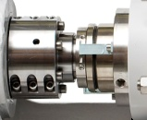
Flowrox PC-Pump
Stepless Adjustable Suction Pipe
Gear Motor
Rigid and Tight Spiral Stator
Robust Bearing unit
Coupling with guard
Patented Shaft Seal Assembly
Base Plate with replaceable fixing bolts

Slide 19
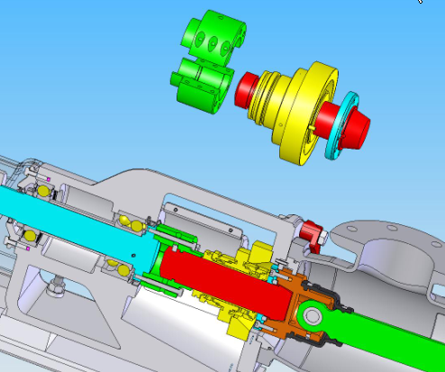
Patented Flowrox Double Action Mechanical Shaft Seal Assembly
Revolutionary fast shaft seal replacement without dismantling the pump

Slide 20
Rotors and Stators
1-lobe rotor
Conventional stator
2-lobe rotor
Flowrox Spiral Stator

Slide 21
Elliptic Rotor vs Round Rotor (2-lobe vs 1-lobe)

Slide 22
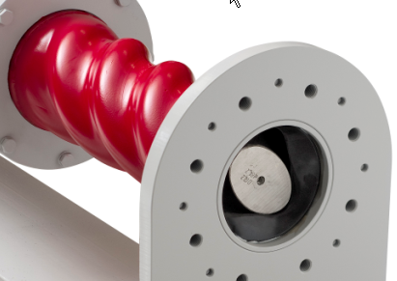
Spiral Stator and 2-Lobe Rotor
Rigid and tighter pumping unit
Smaller interference between rotor and stator
Lower starting torque
Significantly higher pumping efficiency

Slide 23
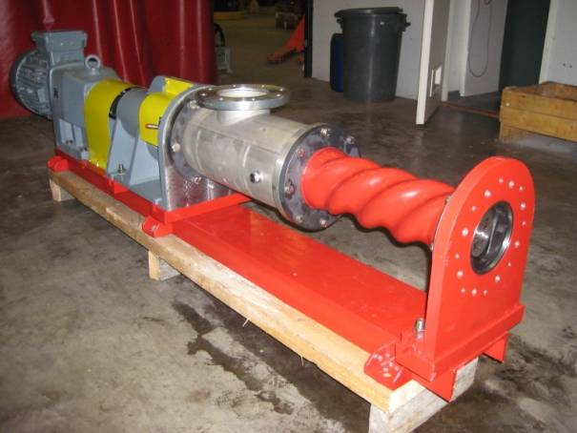
Hydraulic Performance
Competitor
Competitor:
200rpm, 0…6bar, drop=28,6%
300rpm, 0…6bar, drop=17,4%
LFS:
200rpm, 0…6bar, drop=11,5%
300rpm, 0…6bar, drop=8,1%
15.4.2010

Slide 24
Benefits of Flowrox PC-Pump
Higher Efficiency
Easy to Install
Fast Maintenance
Lower Power Consumption
Longer Service Life Time

Slide 25
Thank you for your attention

